Slide 1


Lecture 17
Produced by Dr. Worldwide
Welcome to the 305
~
~

Slide 2

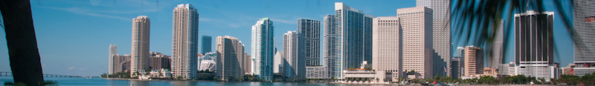
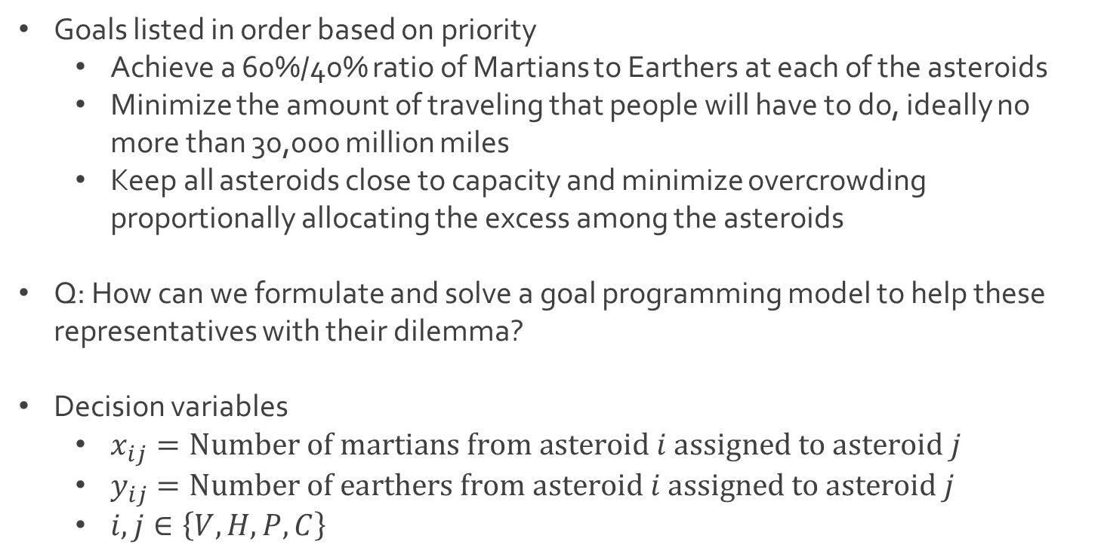
Ex: The Expanse
Goals listed in order based on priority
Achieve a 60%/40% ratio of Martians to Earthers at each of the asteroids
Minimize the amount of traveling that people will have to do, ideally no more than 30,000 million miles
Keep all asteroids close to capacity and minimize overcrowding proportionally allocating the excess among the asteroids
Q: How can we formulate and solve a goal programming model to help these representatives with their dilemma?
Decision variables
$x_{ij}=Number of martians from asteroid i assigned to asteroid j$
$y_{ij}=Number of earthers from asteroid i assigned to asteroid j$
$i,j∈\left\{V,H,P,C\right\}$

Slide 3
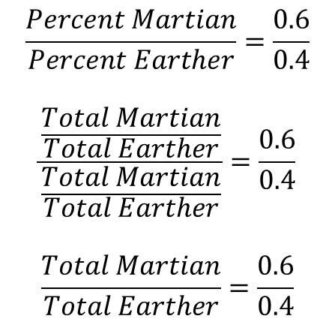
Ex: The Expanse
Goal 1: Achieve fair representation in all 4 asteroids
Consider perfect balance for Vesta
$$\frac{Percent Martian}{Percent Earther}=\frac{0.6}{0.4}$$
$$\frac{\frac{Total Martian}{Total Earther}}{\frac{Total Martian}{Total Earther}}=\frac{0.6}{0.4}$$
$$\frac{Total Martian}{Total Earther}=\frac{0.6}{0.4}$$
$$0.4\left(Total Martian\right)−0.6\left(Total Earther\right)=0$$
$$0.4\left(x_{VV}+x_{HV}+x_{PV}+x_{CV}\right)−0.6\left(y_{VV}+y_{HV}+y_{PV}+y_{CV}\right)=0$$

Slide 4
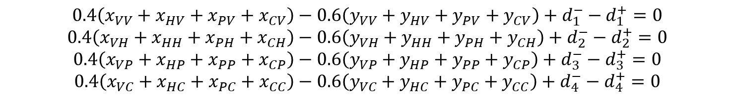
Ex: The Expanse
Goal 1: Achieve fair representation in all 4 asteroids
Adding deviational variables for Vesta
Consider constraints for each of the asteroids
To accomplish our goal, we want all of these deviational variables to be as small as possible
First priority objective
$$0.4\left(x_{VV}+x_{HV}+x_{PV}+x_{CV}\right)−0.6\left(y_{VV}+y_{HV}+y_{PV}+y_{CV}\right)+d_{1}^{−}−d_{1}^{+}=0$$
$$0.4\left(x_{VV}+x_{HV}+x_{PV}+x_{CV}\right)−0.6\left(y_{VV}+y_{HV}+y_{PV}+y_{CV}\right)+d_{1}^{−}−d_{1}^{+}=0$$
$$0.4\left(x_{VH}+x_{HH}+x_{PH}+x_{CH}\right)−0.6\left(y_{VH}+y_{HH}+y_{PH}+y_{CH}\right)+d_{2}^{−}−d_{2}^{+}=0$$
$$0.4\left(x_{VP}+x_{HP}+x_{PP}+x_{CP}\right)−0.6\left(y_{VP}+y_{HP}+y_{PP}+y_{CP}\right)+d_{3}^{−}−d_{3}^{+}=0$$
$$0.4\left(x_{VC}+x_{HC}+x_{PC}+x_{CC}\right)−0.6\left(y_{VC}+y_{HC}+y_{PC}+y_{CC}\right)+d_{4}^{−}−d_{4}^{+}=0$$
$$Minimize P_{1}(d_{1}^{−}+d_{1}^{+}+d_{2}^{−}+d_{2}^{+}+d_{3}^{−}+d_{3}^{+}+d_{4}^{−}+d_{4}^{+})$$

Slide 5
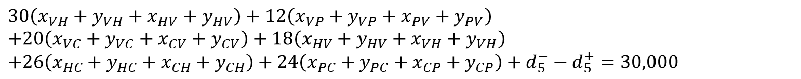
Ex: The Expanse
Goal 2: Minimize total travel to not much more than 30,000 million miles
Recall the following table in millions of miles
Formulation for constraint based on total miles
Updated objective function for second priority
Asteroid | Vesta | Hygiea | Pallas | Ceres
Vesta | - | 30 | 12 | 20
Hygiea | 30 | - | 18 | 26
Pallas | 12 | 18 | - | 24
Ceres | 20 | 26 | 24 | -
$$30\left(x_{VH}+y_{VH}+x_{HV}+y_{HV}\right)+12\left(x_{VP}+y_{VP}+x_{PV}+y_{PV}\right)$$
$$+20\left(x_{VC}+y_{VC}+x_{CV}+y_{CV}\right)+18\left(x_{HV}+y_{HV}+x_{VH}+y_{VH}\right)$$
$$+26\left(x_{HC}+y_{HC}+x_{CH}+y_{CH}\right)+24\left(x_{PC}+y_{PC}+x_{CP}+y_{CP}\right)+d_{5}^{−}−d_{5}^{+}=30,000$$
$$Minimize P_{1}\left(d_{1}^{−}+d_{1}^{+}+d_{2}^{−}+d_{2}^{+}+d_{3}^{−}+d_{3}^{+}+d_{4}^{−}+d_{4}^{+}\right), P_{2}(d_{5}^{+})$$

Slide 6
Ex: The Expanse
Goal 3: Minimize overcrowding at each asteroid, proportionally allocating the excess among the asteroids
Recall the following table
Recall that there are 5,000 total people for capacity of 4,400
The excess of 600 people needs to be split between the asteroids
Q: How can we handle this proportionally?
Asteroid | # of Martians | # of Earthers | Capacity
Vesta | 1000 | 300 | 1200
Hygiea | 450 | 800 | 1000
Pallas | 1050 | 400 | 1000
Ceres | 500 | 500 | 1200

Slide 7
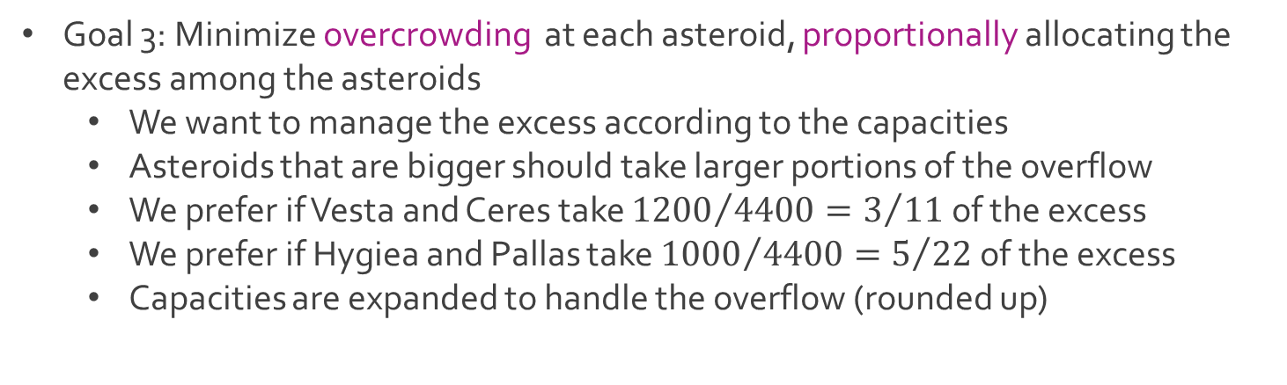
Ex: The Expanse
Goal 3: Minimize overcrowding at each asteroid, proportionally allocating the excess among the asteroids
We want to manage the excess according to the capacities
Asteroids that are bigger should take larger portions of the overflow
We prefer if Vesta and Ceres take ${1200}/{4400}=3/{11}$ of the excess
We prefer if Hygiea and Pallas take ${1000}/{4400}=5/{22}$ of the excess
Capacities are expanded to handle the overflow (rounded up)
Asteroid | Vesta | Hygiea | Pallas | Ceres
Ideal # of People | 1364 | 1136 | 1136 | 1364
$$1200+\frac{3}{11}\left(600\right)=1363.636363≈1364$$

Slide 8

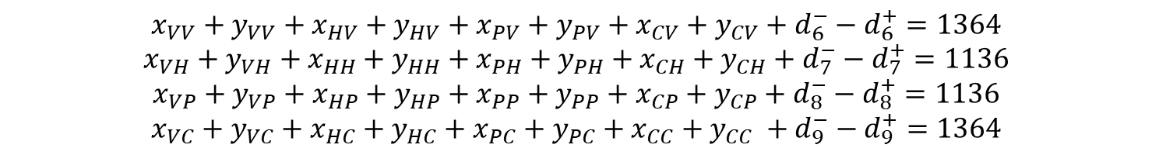
Ex: The Expanse
Goal 3: Minimize overcrowding at each asteroid, proportionally allocating the excess among the asteroids
Constraints with deviational variables
Updated objective function for third priority
$$x_{VV}+y_{VV}+x_{HV}+y_{HV}+x_{PV}+y_{PV}+x_{CV}+y_{CV}+d_{6}^{−}−d_{6}^{+}=1364$$
$$x_{VH}+y_{VH}+x_{HH}+y_{HH}+x_{PH}+y_{PH}+x_{CH}+y_{CH}+d_{7}^{−}−d_{7}^{+}=1136$$
$$x_{VP}+y_{VP}+x_{HP}+y_{HP}+x_{PP}+y_{PP}+x_{CP}+y_{CP}+d_{8}^{−}−d_{8}^{+}=1136$$
$$x_{VC}+y_{VC}+x_{HC}+y_{HC}+x_{PC}+y_{PC}+x_{CC}+y_{CC} +d_{9}^{−}−d_{9}^{+}=1364$$
$$Minimize P_{1}\left(d_{1}^{−}+d_{1}^{+}+d_{2}^{−}+d_{2}^{+}+d_{3}^{−}+d_{3}^{+}+d_{4}^{−}+d_{4}^{+}\right),$$ $P_{2}\left(d_{5}^{+}\right),$
$P_{3}\left(d_{6}^{−}+d_{6}^{+}+d_{7}^{−}+d_{7}^{+}+d_{8}^{−}+d_{8}^{+}+d_{9}^{−}+d_{9}^{+}\right)$

Slide 9

Ex: The Expanse
Additional constraints
We cannot move more people than what is currently available
List of constraints
Asteroid | # of Martians | # of Earthers | Capacity
Vesta | 1000 | 300 | 1200
Hygiea | 450 | 800 | 1000
Pallas | 1050 | 400 | 1000
Ceres | 500 | 500 | 1200
$$x_{VV}+x_{VH}+x_{VP}+x_{VC}=1000$$
$$y_{VV}+y_{VH}+y_{VP}+y_{VC}=300$$
$$x_{HV}+x_{HH}+x_{HP}+x_{HC}=450$$
$$y_{HV}+y_{HH}+y_{HP}+y_{HC}=800$$
$$x_{PV}+x_{PH}+x_{PP}+x_{PC}=1050$$
$$y_{PV}+y_{PH}+y_{PP}+y_{PC}=400$$
$$x_{CV}+x_{CH}+x_{CP}+x_{CC}=500$$
$$y_{CV}+y_{CH}+y_{CP}+y_{CC}=500$$

Slide 10
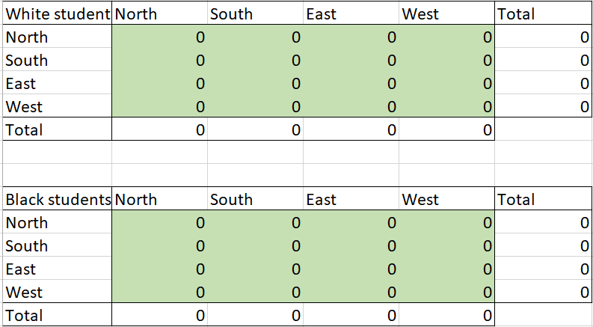
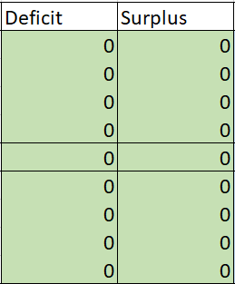

Ex: The Expanse
Additional integer constraints
Download Expanse.xlsx from link Sheet 1 on course website
Tab called Priority 1
Matrices of decision variables
$$x_{ij}∈\{0,1,⋯\}$$
$$y_{ij}∈\{0,1,⋯\}$$

Slide 11
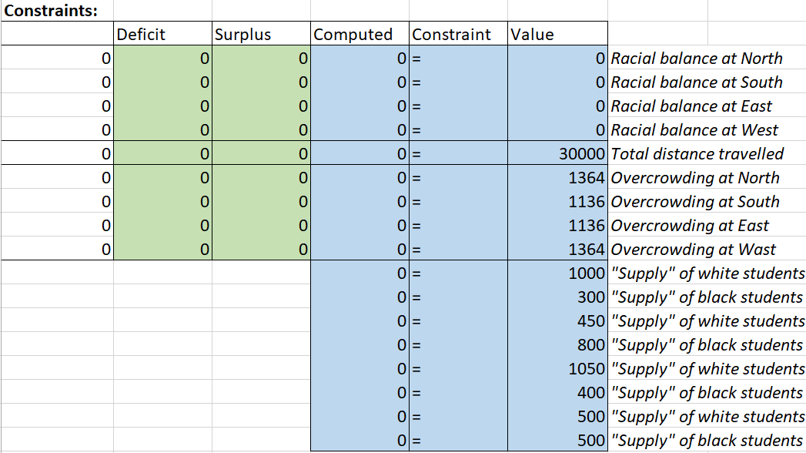
Ex: The Expanse
Tab called Priority 1
Notice all the different constraints and inspect formulas

Slide 12

Ex: The Expanse
Tab called Priority 1
First objective function
Observe formula for objective function
Q: What is “B20:C23” referring to and what is “SUM” doing?
Use Excel solver to find the optimal solution
$$Minimize{ d}_{1}^{−}+d_{1}^{+}+d_{2}^{−}+d_{2}^{+}+d_{3}^{−}+d_{3}^{+}+d_{4}^{−}+d_{4}^{+}$$
=SUM(B20:C23)

Slide 13
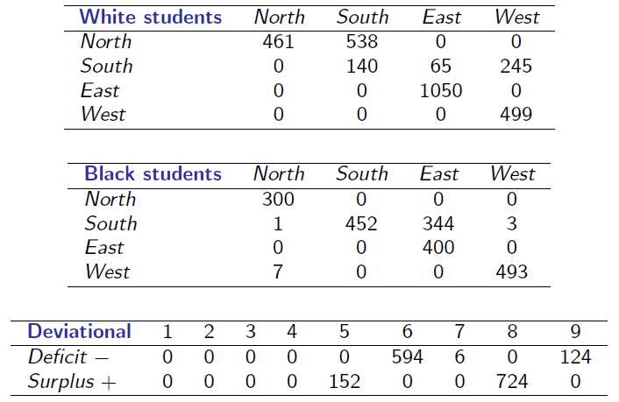
Ex: The Expanse
Tab called Priority 1
Optimal solution

Slide 14

Ex: The Expanse
Tab called Priority 2
Notice the additional constraint and inspect formula
Second objective function
Observe formula for objective function
Use Excel solver to find optimal solution
$$Minimize{ d}_{5}^{+}$$
=SUM(C24)

Slide 15
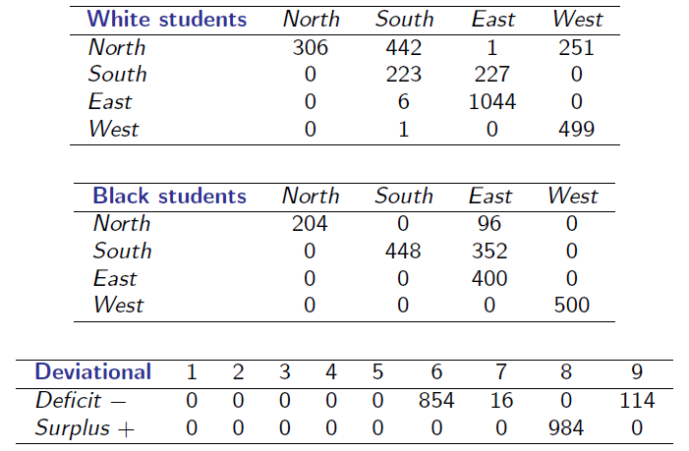
Ex: The Expanse
Tab called Priority 2
Optimal solution

Slide 16


Ex: The Expanse
Tab called Priority 3
Notice the additional constraint
Second objective function
Formula for this objective similar to first objective
Use Excel solver to find optimal solution
$$Minimize{ d}_{6}^{−}+d_{6}^{+}+d_{7}^{−}+d_{7}^{+}+d_{8}^{−}+d_{8}^{+}+d_{9}^{−}+d_{9}^{+}$$
=SUM(C24)

Slide 17
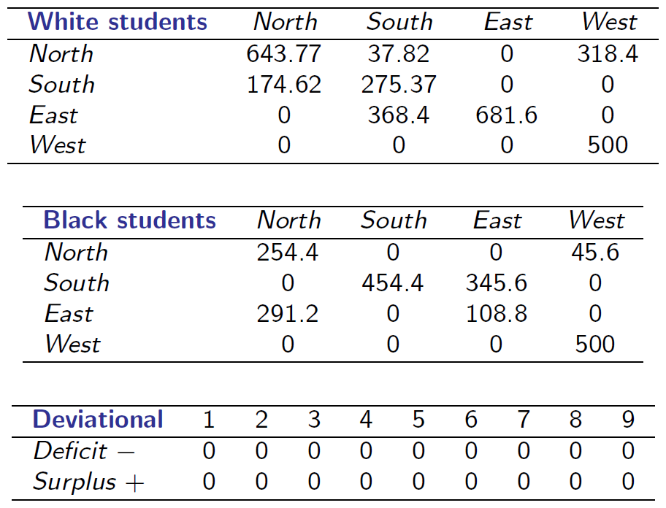
Ex: The Expanse
Tab called Priority 3
Optimal solution
Q: What is the problem with the optimal solution?

Slide 18
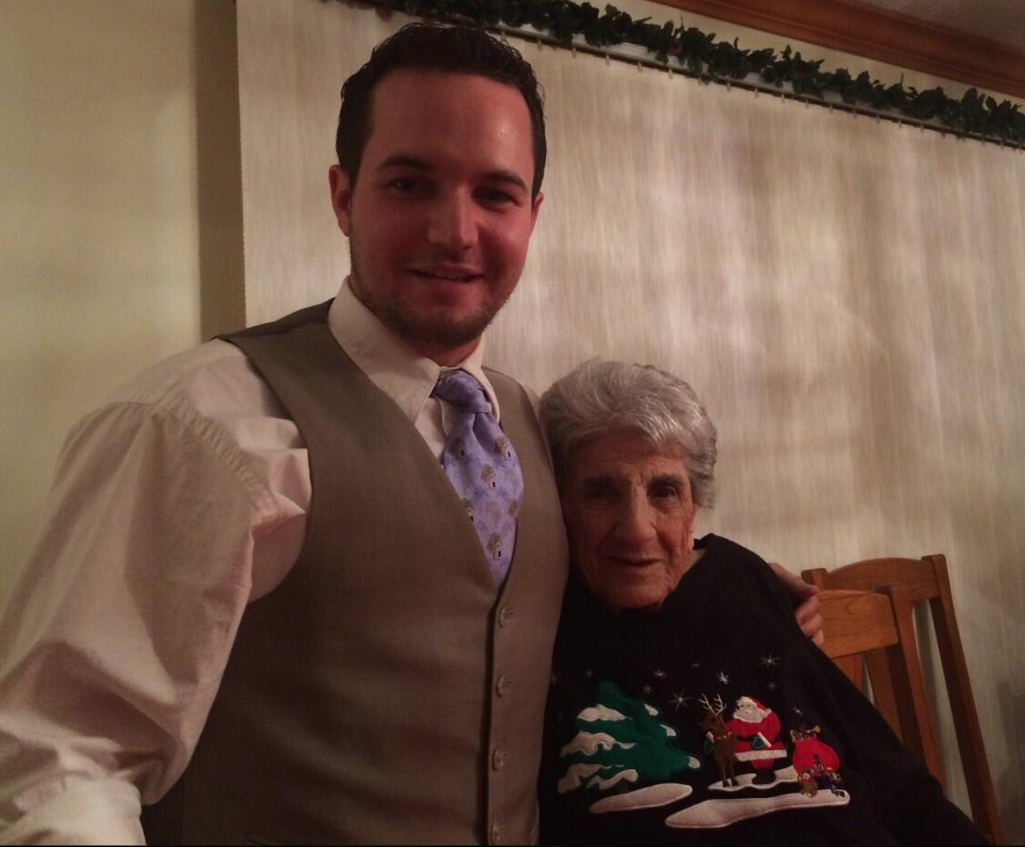
Ex: The Expanse
Tab called Priority 3
Q: What do you mean you cannot bus half a person?
Try to add integer constraints and see what happens

Slide 19




The End
Dale

